Slide 1
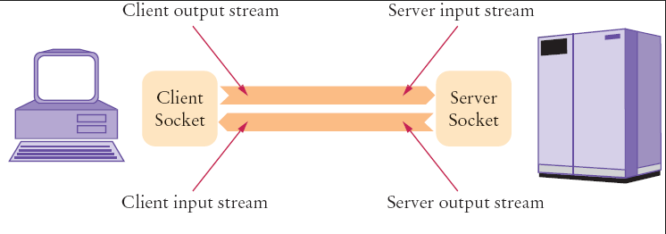
Java Socket Programming - Chat Application

